Slide 1
Classification using Decision Trees
BY
A.SIRISHA

Slide 2
Illustrating Classification Task

Slide 3
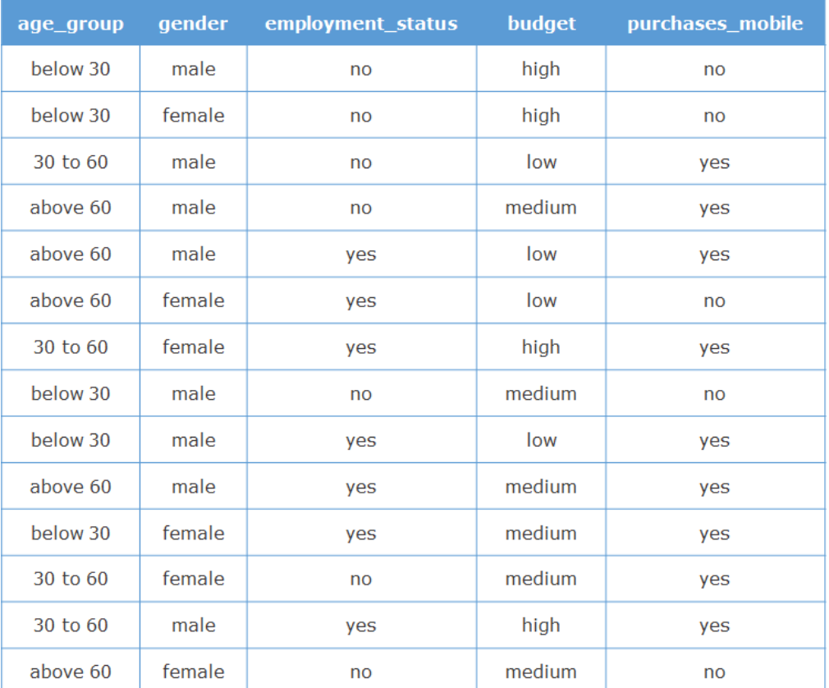
Customer data set of an online mobile portal
Total Instances=14, No. of samples(purchases_mobile=‘yes’)=9.
No. of samples(purchases_mobile=‘No’)=5.
Notes:
The dataset contains details of all the customers who had previously visited the portal.
We want to predict whether a new customer would buy a mobile or not, given various other features. Since the target value is a discrete 'Yes' or 'No', it is a classification problem.

Slide 4
Predicting whether a new customer would buy a mobile or not
What is the probability of a male customer purchasing a mobile?
Ans: 6/8 = 0.75
What is the probability of a customer with medium budget purchasing a mobile?
Ans: 2/4 = 0.50
What is the probability of customer with the age group 30 to 60 purchas a mobile?
Ans: 4/4 = 1
It is observed that the historical data can be split on a particular predictor into subsets of data in order to answer these questions.
The information that is derived from these splits can help predict the outcome better.

Slide 5
Splitting the Dataset
Let us now split the data set on ‘gender' attribute which takes one of 2 values - ‘male' or ‘female'.
gender=female (class label yes:3,No:3), Total=6
gender=male (class label yes :6,No:2), Total=8
age_group | gender | employment_status | budget | purchase_mobile
below 30 | female | no | high | no
above 60 | female | yes | low | no
30 to 60 | female | yes | high | yes
below 30 | female | yes | medium | yes
30 to 60 | female | no | medium | yes
above 60 | female | no | medium | no
age_group | gender | employment_status | budget | purchase_mobile
below 30 | male | no | high | no
30 to 60 | male | no | low | yes
above 60 | male | no | medium | yes
above 60 | male | yes | low | yes
below 30 | male | no | medium | no
below 30 | male | yes | low | yes
above 60 | male | yes | medium | yes
30 to 60 | male | yes | high | yes

Slide 6
Splitting the Dataset
Let us now split the data set on employment_status' attribute which takes one of 2 values - 'yes' or 'no'.
employment_status=yes (class label yes :6,No:1), Total=7
employment_status=No (class label yes :3,No:4), Total=7
age_group | gender | employment_status | budget | purchase_mobile
above 60 | male | yes | low | yes
above 60 | female | yes | low | no
30 to 60 | female | yes | high | yes
below 30 | male | yes | low | yes
above 60 | male | yes | medium | yes
below 30 | female | yes | medium | yes
30 to 60 | male | yes | high | yes
age_group | gender | employment_status | budget | purchase_mobile
below 30 | male | no | high | no
below 30 | female | no | high | no
30 to 60 | male | no | low | yes
above 60 | male | no | medium | yes
below 30 | male | no | medium | no
30 to 60 | female | no | medium | yes
above 60 | female | no | medium | no

Slide 7
Splitting the Dataset
Budget=low (yes: 3, No :1) , Total =4
Budget= medium (yes:4,No:2), Total =6
Budget= high (yes:2, No: 2), Total=4
age_group | gender | employment_status | budget | purchase_mobile
30 to 60 | male | no | low | yes
above 60 | male | yes | low | yes
above 60 | female | yes | low | no
below 30 | male | yes | low | yes
First, split the dataset on the 'budget' attribute, which takes one of the 3 values - 'low', 'medium' or 'high‘.
It is observed that the above split does not result in any subset that contains the instances of class label ("purchases_mobile") either only 'yes' or only 'no'.
This means, just by looking at the 'budget' value, you cannot predict if a person will buy a mobile.
age_group | gender | employment_status | budget | purchase_mobile
above 60 | male | no | medium | yes
below 30 | male | no | medium | no
above 60 | male | yes | medium | yes
below 30 | female | yes | medium | yes
30 to 60 | female | no | medium | yes
above 60 | female | no | medium | no
age_group | gender | employment_status | budget | purchase_mobile
below 30 | male | no | High | no
below 30 | female | no | high | no
30 to 60 | female | yes | high | yes
30 to 60 | male | yes | high | yes

Slide 8
Splitting the Dataset
Age_group=30 to 60 (yes: 4, No :0) , Total =4
Age_group= below 30(yes: 2, No :3) , Total =5
Age_group=above 60 (yes: 3, No :2) , Total =5
Split the dataset on the ‘age_group' attribute, which takes one of the 3 values - ‘below 30,’30 to 60’,
above 60.
It is observed that the above split resulted in one subset that contains the instances of class("purchases_mobile") label only 'yes'
This means, just by looking at the ‘age_group' value, you may predict if a person will buy a mobile.
age_group | gender | employment_status | budget | purchase_mobile
30 to 60 | male | no | low | yes
30 to 60 | female | yes | high | yes
30 to 60 | female | no | medium | yes
30 to 60 | male | yes | high | yes
age_group | gender | employment_status | budget | purchase_mobile
below 30 | male | no | high | no
below 30 | female | no | high | no
below 30 | male | no | medium | no
below 30 | male | yes | low | yes
below 30 | female | yes | medium | yes
age_group | gender | employment_status | budget | purchase_mobile
above 60 | male | no | medium | yes
above 60 | male | yes | low | yes
above 60 | female | yes | low | no
above 60 | male | yes | medium | yes
above 60 | female | no | medium | no

Slide 9
Splitting the Dataset
A subset which contains instances belonging to only one class label is called a pure (homogeneous) subset.
The predictor attribute on which the dataset is split to obtain the maximum number of pure subsets is called the best attribute.
At this point, you can observe that the subsets formed for age group 'below 30' and 'above 60' categories are impure. Hence, the next goal is to keep splitting the impure subsets based on other attributes, until a pure subset is derived.

Slide 10
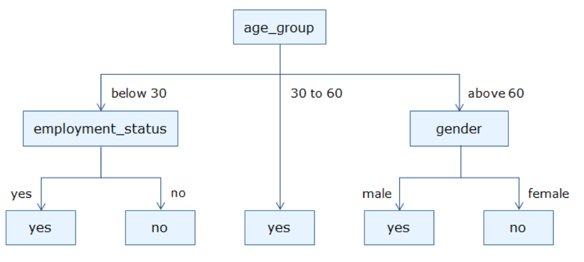
Splitting process
The end result of the splitting process for the sample data based on the split attribute:age_group results in the following splits:
age_group | gender | employment_status | budget | purchase_mobile
30 to 60 | male | no | low | yes
30 to 60 | female | yes | high | yes
30 to 60 | female | no | medium | yes
30 to 60 | male | yes | high | yes
age_group | gender | employment_status | budget | purchase_mobile
below 30 | male | no | high | no
below 30 | female | no | high | no
below 30 | male | no | medium | no
below 30 | male | yes | low | yes
below 30 | female | yes | medium | yes
age_group | gender | employment_status | budget | purchase_mobile
above 60 | male | no | medium | yes
above 60 | male | yes | low | yes
above 60 | female | yes | low | no
above 60 | male | yes | medium | yes
above 60 | female | no | medium | no
Notes:
The above diagram looks like an inverted tree. Also, since a decision is taken on how to split the data at each node of the tree, this algorithm is called a Decision Tree.

Slide 11
Splitting the Dataset
After the attribute age_group=below 30, let us now split the data set on ‘gender' attribute which takes one of 2 values - ‘male' or ‘female'.
gender=male (class label yes:1,No:2), Total=3
gender=male (class label yes :1,No:1), Total=2
age_group | gender | employment_status | budget | purchase_mobile
below 30 | male | no | high | no
below 30 | male | no | medium | no
below 30 | male | yes | low | yes
age_group | gender | employment_status | budget | purchase_mobile
below 30 | female | no | high | no
below 30 | female | yes | medium | yes

Slide 12
Splitting the Dataset
After the attribute age_group=above 60, let us now split the data set on ‘gender' attribute which takes one of 2 values - ‘male' or ‘female'.
gender=male (class label yes:3,No:0), Total=3
gender=female (class label yes :0,No:2), Total=2
age_group | gender | employment_status | budget | purchase_mobile
above 60 | male | no | medium | yes
above 60 | male | yes | low | yes
above 60 | male | yes | medium | yes
age_group | gender | employment_status | budget | purchase_mobile
above 60 | female | yes | low | no
above 60 | female | no | medium | no

Slide 13
Splitting the Dataset
After the attribute age_group, let us now split the data set on ‘employment_status' attribute which takes one of 2 values - ‘yes' or ‘no'.
employment_status = no (class label yes:0,No:3), Total=3
employment_status =yes (class label yes :2,No:0), Total=2
age_group | gender | employment_status | budget | purchase_mobile
below 30 | male | no | high | no
below 30 | female | no | high | no
below 30 | male | no | medium | no
age_group | gender | employment_status | budget | purchase_mobile
below 30 | male | yes | low | yes
below 30 | female | yes | medium | yes

Slide 14
Splitting process
The end result of the splitting process for the sample data results in the following splits:
Notes:
The above diagram looks like an inverted tree. Also, since a decision is taken on how to split the data at each node of the tree, this algorithm is called a Decision Tree.

Slide 15
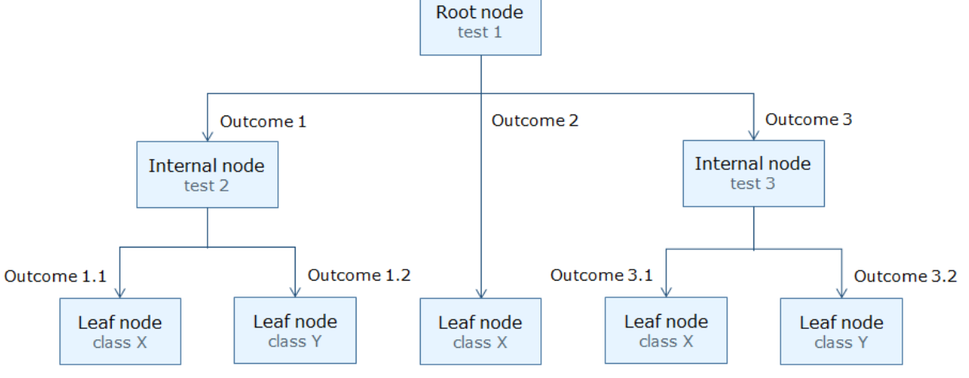
Decision Tree definition
A decision tree is a tree-like structure in which:
the root node and each internal node represent a "test" on an attribute of an instance in the dataset.
the outcome of each test is represented by the corresponding branches.
the node that does not branch further is called a leaf node and represents the class labels.

Slide 16
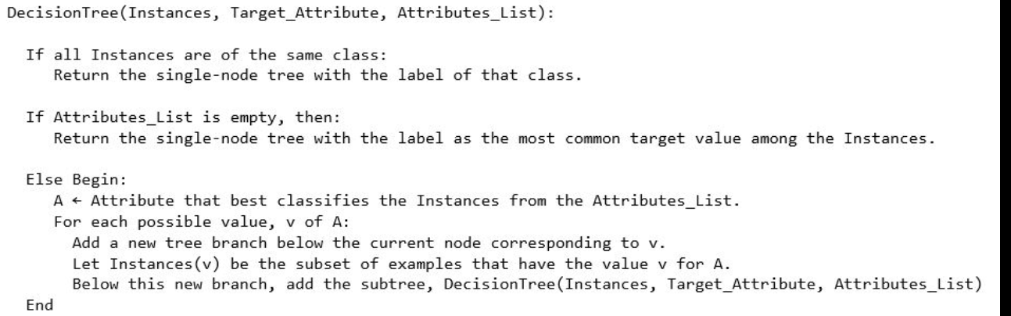
Decision Tree Algorithm
It takes three parameters:
Instances – the set of instances or samples with known class labels.
Target_Attribute – the class label attribute.
Attributes_List – the list of predictor attributes.
Notes:
It takes three parameters:
Instances – the set of instances or samples, for which, class labels are already known.
Target_Attribute – the class label attribute.
Attributes_List – the list of predictor attributes.

Slide 17
Attribute selection Measures
The selection of the best attribute is performed based on various attribute selection measures.
Three of the most commonly used attribute selection measures to induct a decision tree are:
Information gain
Gain ratio
Gini Index
Attribute selection measures compare different predictor attributes and rank them for the purpose of model building.
Decision tree algorithms makes use of the ranked list given by the attribute selection measures and then selects the best attribute to split the dataset
Notes:
Attribute selection measures compare different predictor attributes and rank them for the purpose of model building. These measures convey information about the relevance of a predictor when compared to other predictors.
Decision tree algorithms makes use of the ranked list given by the attribute selection measures and then selects the best attribute to split the dataset

Slide 18

Constructing Decision Trees
There are different decision tree algorithms, but they are almost all variants of the same principle:
The algorithms build the tree in a greedy manner starting at the root, choosing the most informative feature at each step.
In 1948 Claude Shannon proposed the measure of information entropy, which describes the amount of impurity in a collection of training examples.

Slide 19
Entropy
Let F be a feature with possible values f₁, …, f_{n}
Let p_{i} is the proportion of the data that has value F=f_{i}.
Entropy tells us how much extra information we get from knowing the value of the feature, i.e, F=f_{i} for a given data point .
Makes sense to pick the features that provides the most information

Slide 20
Entropy
The entropy is 0 if all members of S belong to the same class.
For example:
if all members are positive (p+ = I), then p- is 0, and
Entropy(S) = -1 . log2(1) - 0 . log2 0
= -1 . 0 - 0 . log2 0
= 0.
The entropy is 1 when the collection contains an equal number of positive and negative examples.
If the collection contains unequal numbers of positive and negative examples, The entropy is between 0 and 1

Slide 21
Information Gain
The important idea is to work out how much the entropy of the whole training set would decrease if we choose each particular feature for the next classification step. This is known as the information gain.
Information gain is defined as the entropy of the whole set minus the entropy when a particular feature is chosen.
Information gain also defined as the Expected reduction in entropy caused by partitioning the collection according to an attribute.
Notes:
Expected reduction in entropy caused by partitioning the collection according to an attribute.

Slide 22
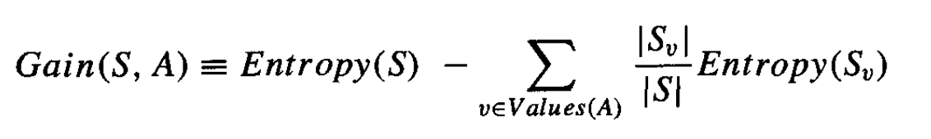
Information Gain
where S is the set of examples,
v is a possible value out of the set of all possible ones of the feature “A”, and |S_{v} | is a count of the number of members of S that have value v for feature “A”.
Choose the feature that provides the highest information gain over all examples
At each stage, pick the feature with the highest information gain

Slide 23

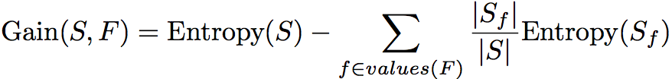

Slide 24
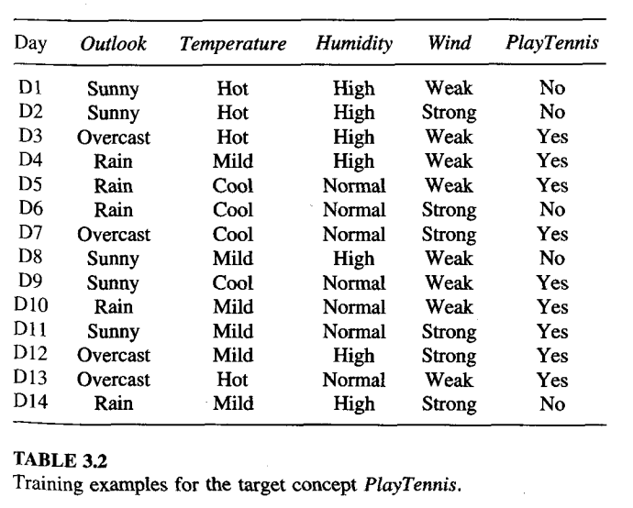
Dataset

Slide 25
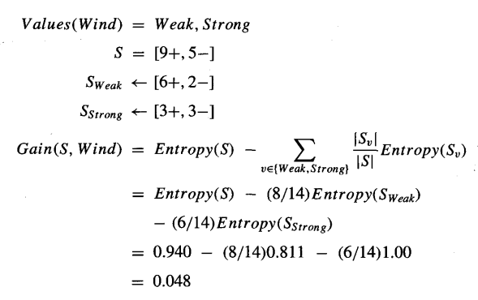
Information Gain for Wind

Slide 26
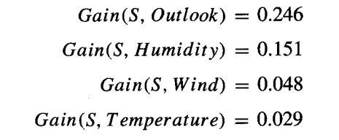
Information Gain for all four attributes
According to the information gain measure, the Outlook attribute provides the best prediction of the target attribute, Play Tennis, over the training examples.
Therefore, Outlook is selected as the decision attribute for the root node, and branches are created below the root for each of its possible values (i.e., Sunny, Overcast, and Rain)

Slide 27
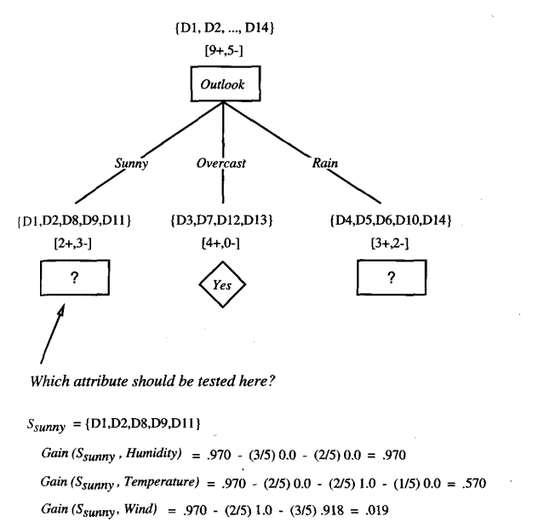

Slide 28
CART
Decision tree algorithms still keep their popularity because they can produce transparent decisions. ID3 uses information gain whereas C4.5 uses gain ratio for splitting. Here, CART is an alternative decision tree building algorithm. It can handle both classification and regression tasks. This algorithm uses a new metric named gini index to create decision points for classification tasks.
Decision rules will be found by GINI index value

Slide 29
Measure of Impurity: GINI
Gini Index for a given node t :
(NOTE: p( j | t) is the relative frequency of class j at node t).

Slide 30
Examples for computing GINI
P(C1) = 0/6 = 0 P(C2) = 6/6 = 1
Gini = 1 – P(C1)² – P(C2)² = 1 – 0 – 1 = 0
P(C1) = 1/6 P(C2) = 5/6
Gini = 1 – (1/6)² – (5/6)² = 0.278
P(C1) = 2/6 P(C2) = 4/6
Gini = 1 – (2/6)² – (4/6)² = 0.444

Slide 31
Splitting Based on GINI
Used in CART, SLIQ, SPRINT.
When a node p is split into k partitions (children), the quality of split is computed as,
where, n_{i} = number of records at child i,
n = number of records at node p.

Slide 32
Example Dataset

Slide 33
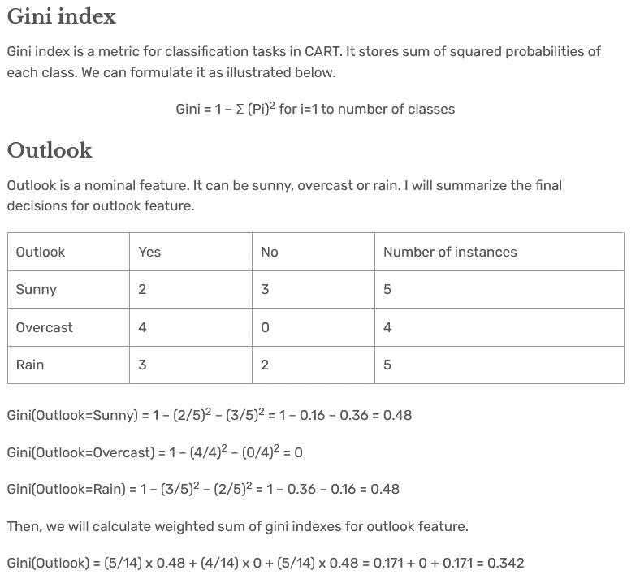

Slide 34
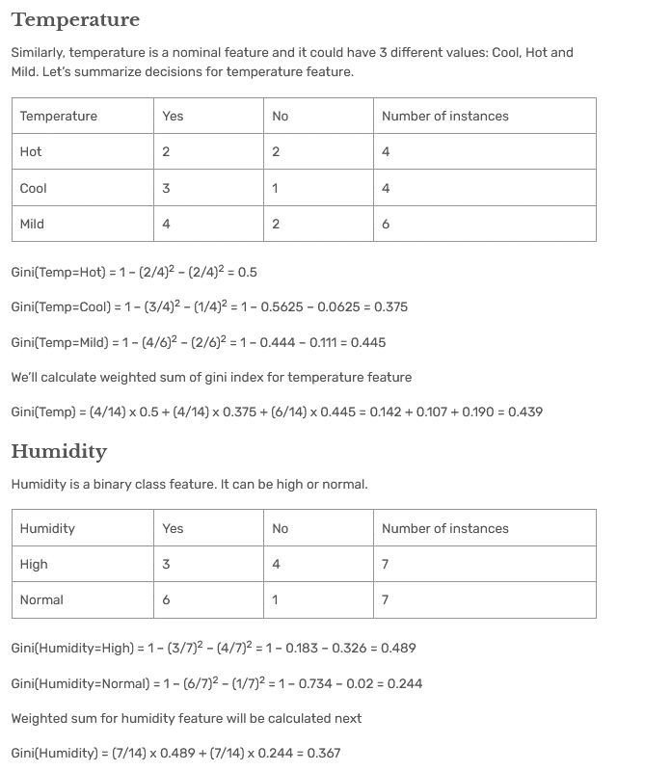

Slide 35
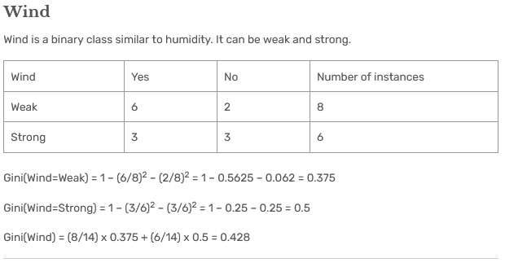

Slide 36
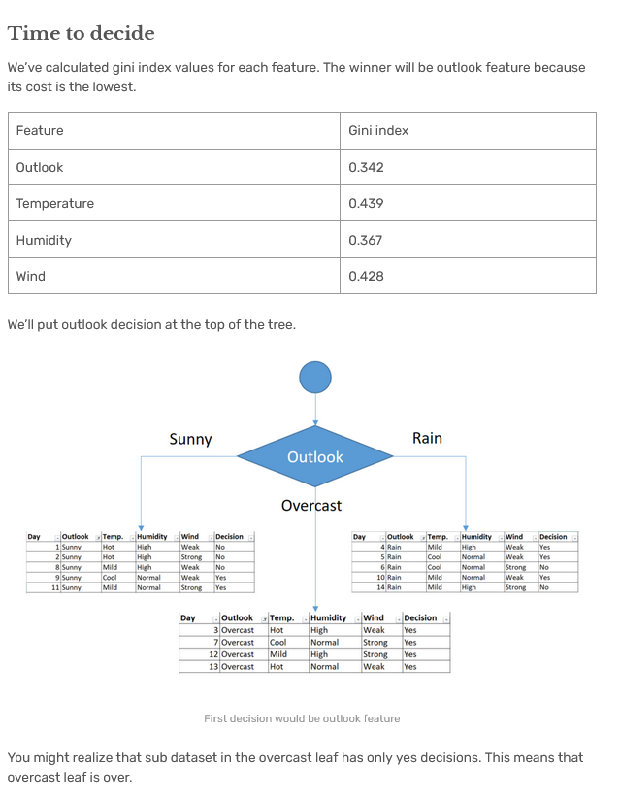

Slide 37
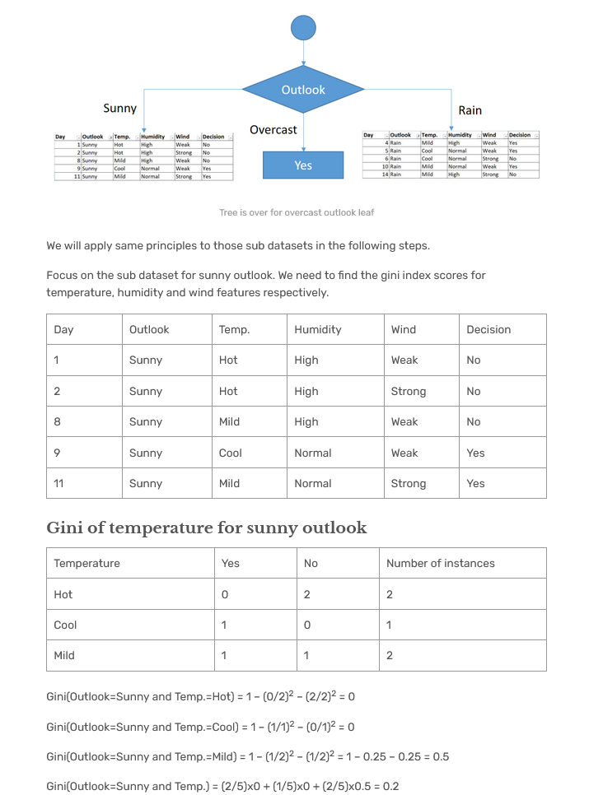

Slide 39
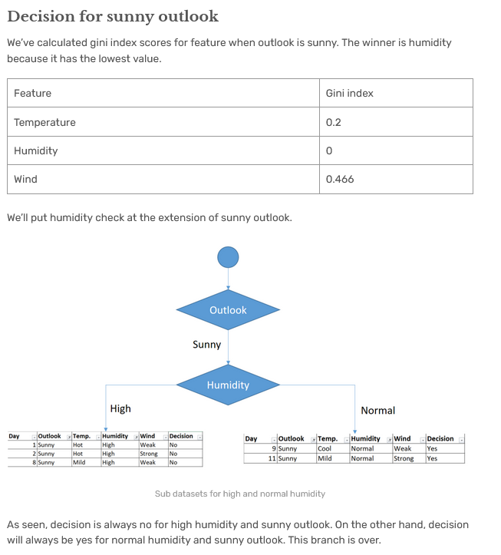

Slide 40
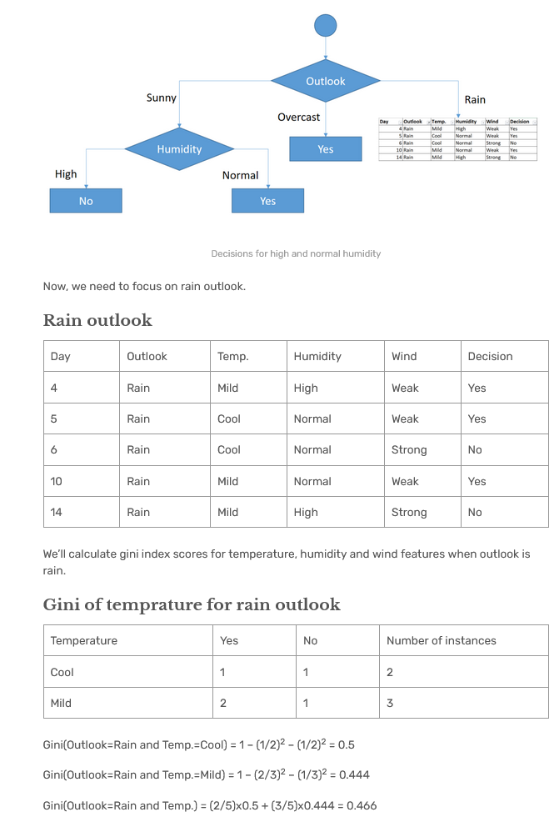

Slide 41
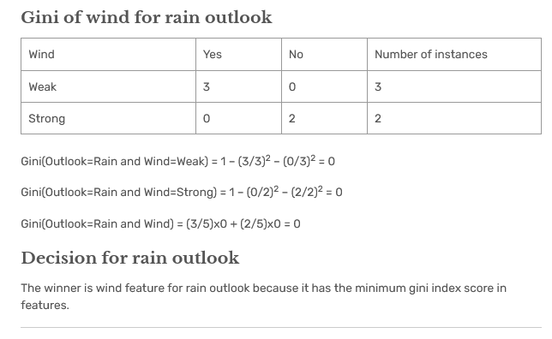

Slide 42
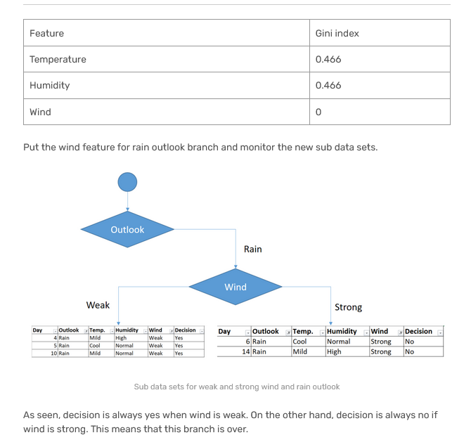

Slide 43
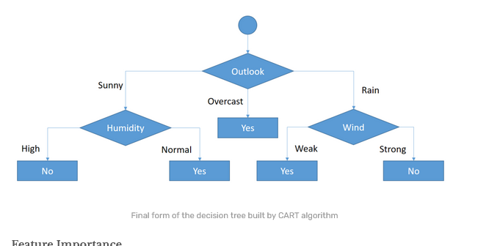
Decision tree for the Play Tennis dataset

Slide 44
Advantages of CART algorithm
The CART algorithm is nonparametric, thus it does not depend on information from a certain sort of distribution.
CART allows one to utilize the same variables many times in various regions of the tree. This skill is capable of revealing intricate interdependencies between groups of variables.
Outliers in the input variables have no meaningful effect on CART.
One can loosen halting restrictions to allow decision trees to overgrow and then trim the tree down to its ideal size. This method reduces the likelihood of missing essential structure in the data set by terminating too soon.
To choose the input set of variables, CART can be used in combination with other prediction algorithms.

Slide 45
Decision Tree
The computational cost of making the tree is fairly low, but the cost of using it is even lower: O(log N), where N is the number of datapoints.
The idea of a decision tree is that
we break classification down into a set of choices about each feature in turn, starting at the root (base) of the tree and progressing down to the leaves, where we receive the classification decision.
The trees are very easy to understand, and can even be turned into a set of if-then rules.

Slide 46
Regression Trees
Regression trees work as decision trees except
Leafs carry numbers which predict the output variable instead of class label
Instead of entropy/purity the squared prediction error serves as the performance measure.
Tests that reduce the squared prediction error the most are selected as node test; test conditions have the form y>threshold where y is an independent variable of the prediction problem.
Instead of using the majority class, leaf labels are generated by averaging over the values of the dependent variable of the examples that are associated with the particular class node

Slide 47
C4.5
Improved version of ID3, also by Quinlan
Use a validation set to avoid overfitting
Could just stop choosing features (early stopping)
Better results from post-pruning
Make whole tree
Chop off some parts of tree afterwards

Slide 48
Post-Pruning
Run over tree
Prune each node by replacing subtree below with a leaf
Evaluate error and keep if error same or better

